Slide 1

Smart Attendance Management System Using Face Recognition with OpenCV
ITA0502– COMPUTER VISION
Presentation By :
192311062 P.Reddy Renuka
192321117 Oviya M
192421032 Thulasi I
192521429 Maha Swetha
192425355 Yambadi thanushma
192425177 Yarrabolu Navya
Program Director : Dr. Sasi Rekha, Prof/CSE
Faculty:- Mrs. R C Jeni Gracia, AP / CSE

Slide 2


Agenda
Introduction
Literature Review
Problem Statement
Objectives
System Architecture - Overall Design of Project
Modules Introduction

Slide 3
Introduction
Smart Attendance Management System Using OpenCV-Based Face Recognition automates the attendance process using computer vision.
It detects and recognizes students' faces through a webcam.
Attendance is recorded automatically with the student's name, date, and time.
The system improves accuracy, saves time, and prevents proxy attendance.
It demonstrates the practical application of OpenCV and Computer Vision in educational institutions.

Slide 4
Literature Review
Author & Year | Method Used | Key Findings | Limitations
Chandra et al. (2021) | OpenCV + Face Recognition | Automated attendance with improved accuracy and reduced manual effort. | Performance decreases under poor lighting and different face angles.
Ashwin Rao (2022) | Face Recognition + Computer Vision | Real-time attendance system with reduced proxy attendance. | Requires a high-quality camera for better recognition accuracy.
A. Kumar et al. (2023) | OpenCV + Face Recognition | Reliable real-time face recognition for attendance management. | Recognition accuracy may decrease when multiple faces are present simultaneously.
Jayaraj Viswanathan et al. (2024) | OpenCV + Machine Learning | Improved attendance efficiency with minimal human intervention. | Performance may be affected by face masks and occlusions.
Divyanshu Bhardwaj et al. (2025) | OpenCV + Flask + Google API | Secure and real-time attendance with cloud integration. | Requires a stable internet connection for cloud-based features.

Slide 5
Problem Statement
Traditional attendance methods are time-consuming and prone to human errors.
Manual attendance allows proxy attendance and inaccurate record keeping.
Existing face recognition systems may perform poorly under varying lighting conditions and face angles
here is a need for a cost-effective, accurate, and real-time attendance system using OpenCV-based face recognition to automate attendance and improve efficiency.

Slide 6
Objectives
To develop a smart attendance management system using OpenCV-based face recognition.
To detect and recognize students' faces in real time using a webcam.
To automatically record attendance with the student's name, date, and time.
To reduce manual effort, human errors, and proxy attendance.
To improve the accuracy and efficiency of attendance management.

Slide 7
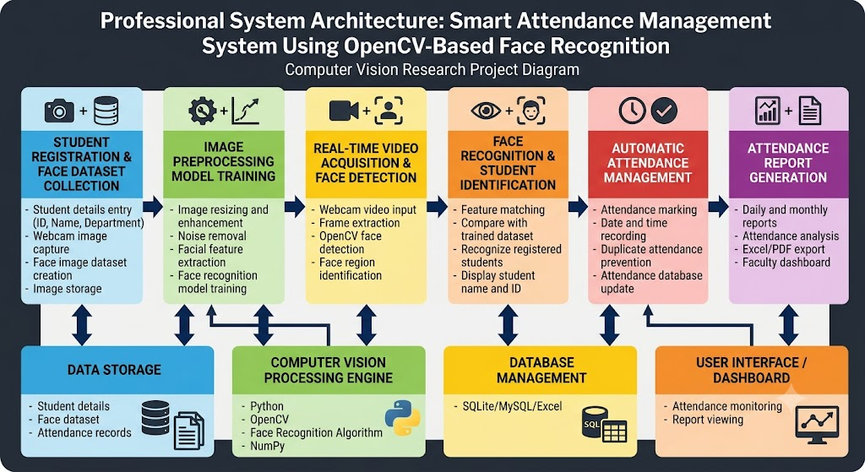
Architecture

Slide 8
Module 1 – Student Registration & Face Dataset Collection
.
This module is the first step of the attendance system, where student information is registered.
The student's ID, Name, and other required details are entered into the system.
Multiple face images of each student are captured using a webcam.
The captured images are stored in a dataset for future face recognition.
This dataset is used to train the face recognition model and improve identification accuracy.

Slide 9
Module 2 – Image Preprocessing & Face Model Training
This module preprocesses the captured face images to improve their quality.
Facial features are extracted from the images using OpenCV techniques.
The processed images are used to train the face recognition model.
The trained model learns to identify registered students accurately.
The trained model is saved and used for real-time face recognition in the next modules.

Slide 10
Module 3 – Real-Time Face Detection
This module captures live video input from a webcam for attendance monitoring.
The system processes each video frame using OpenCV-based face detection techniques.
Detected faces are identified and highlighted using bounding boxes.
The module extracts face regions and prepares them for further recognition.
The detected face information is transferred to the face recognition module for identification.

Slide 11
Module 4 – Face Recognition
This module identifies registered students by comparing detected faces with the stored face dataset.
The system extracts facial features and matches them with the trained recognition model.
OpenCV-based face recognition techniques are used to achieve accurate identification.
The recognized student's name and ID are displayed on the screen.
The identified student details are sent to the attendance management module for recording.

Slide 12
Module 5 – Automatic Attendance Management
This module automatically marks attendance for students recognized by the face recognition system.
The system records the student's name, ID, date, and time of attendance.
It prevents duplicate attendance entries by checking existing records.
The attendance data is stored securely in a database or Excel file.
This module reduces manual effort and improves the accuracy of attendance management.

Slide 13
Module 6– Attendance Report Generation
This module generates attendance reports from the stored attendance records.
The system allows users to view attendance details based on students and dates.
Daily and monthly attendance summaries can be created for monitoring purposes.
Attendance reports can be exported in formats such as Excel or PDF.
This module helps faculty efficiently analyze and manage student attendance data.

Slide 14

THANK YOU

